Slide 1
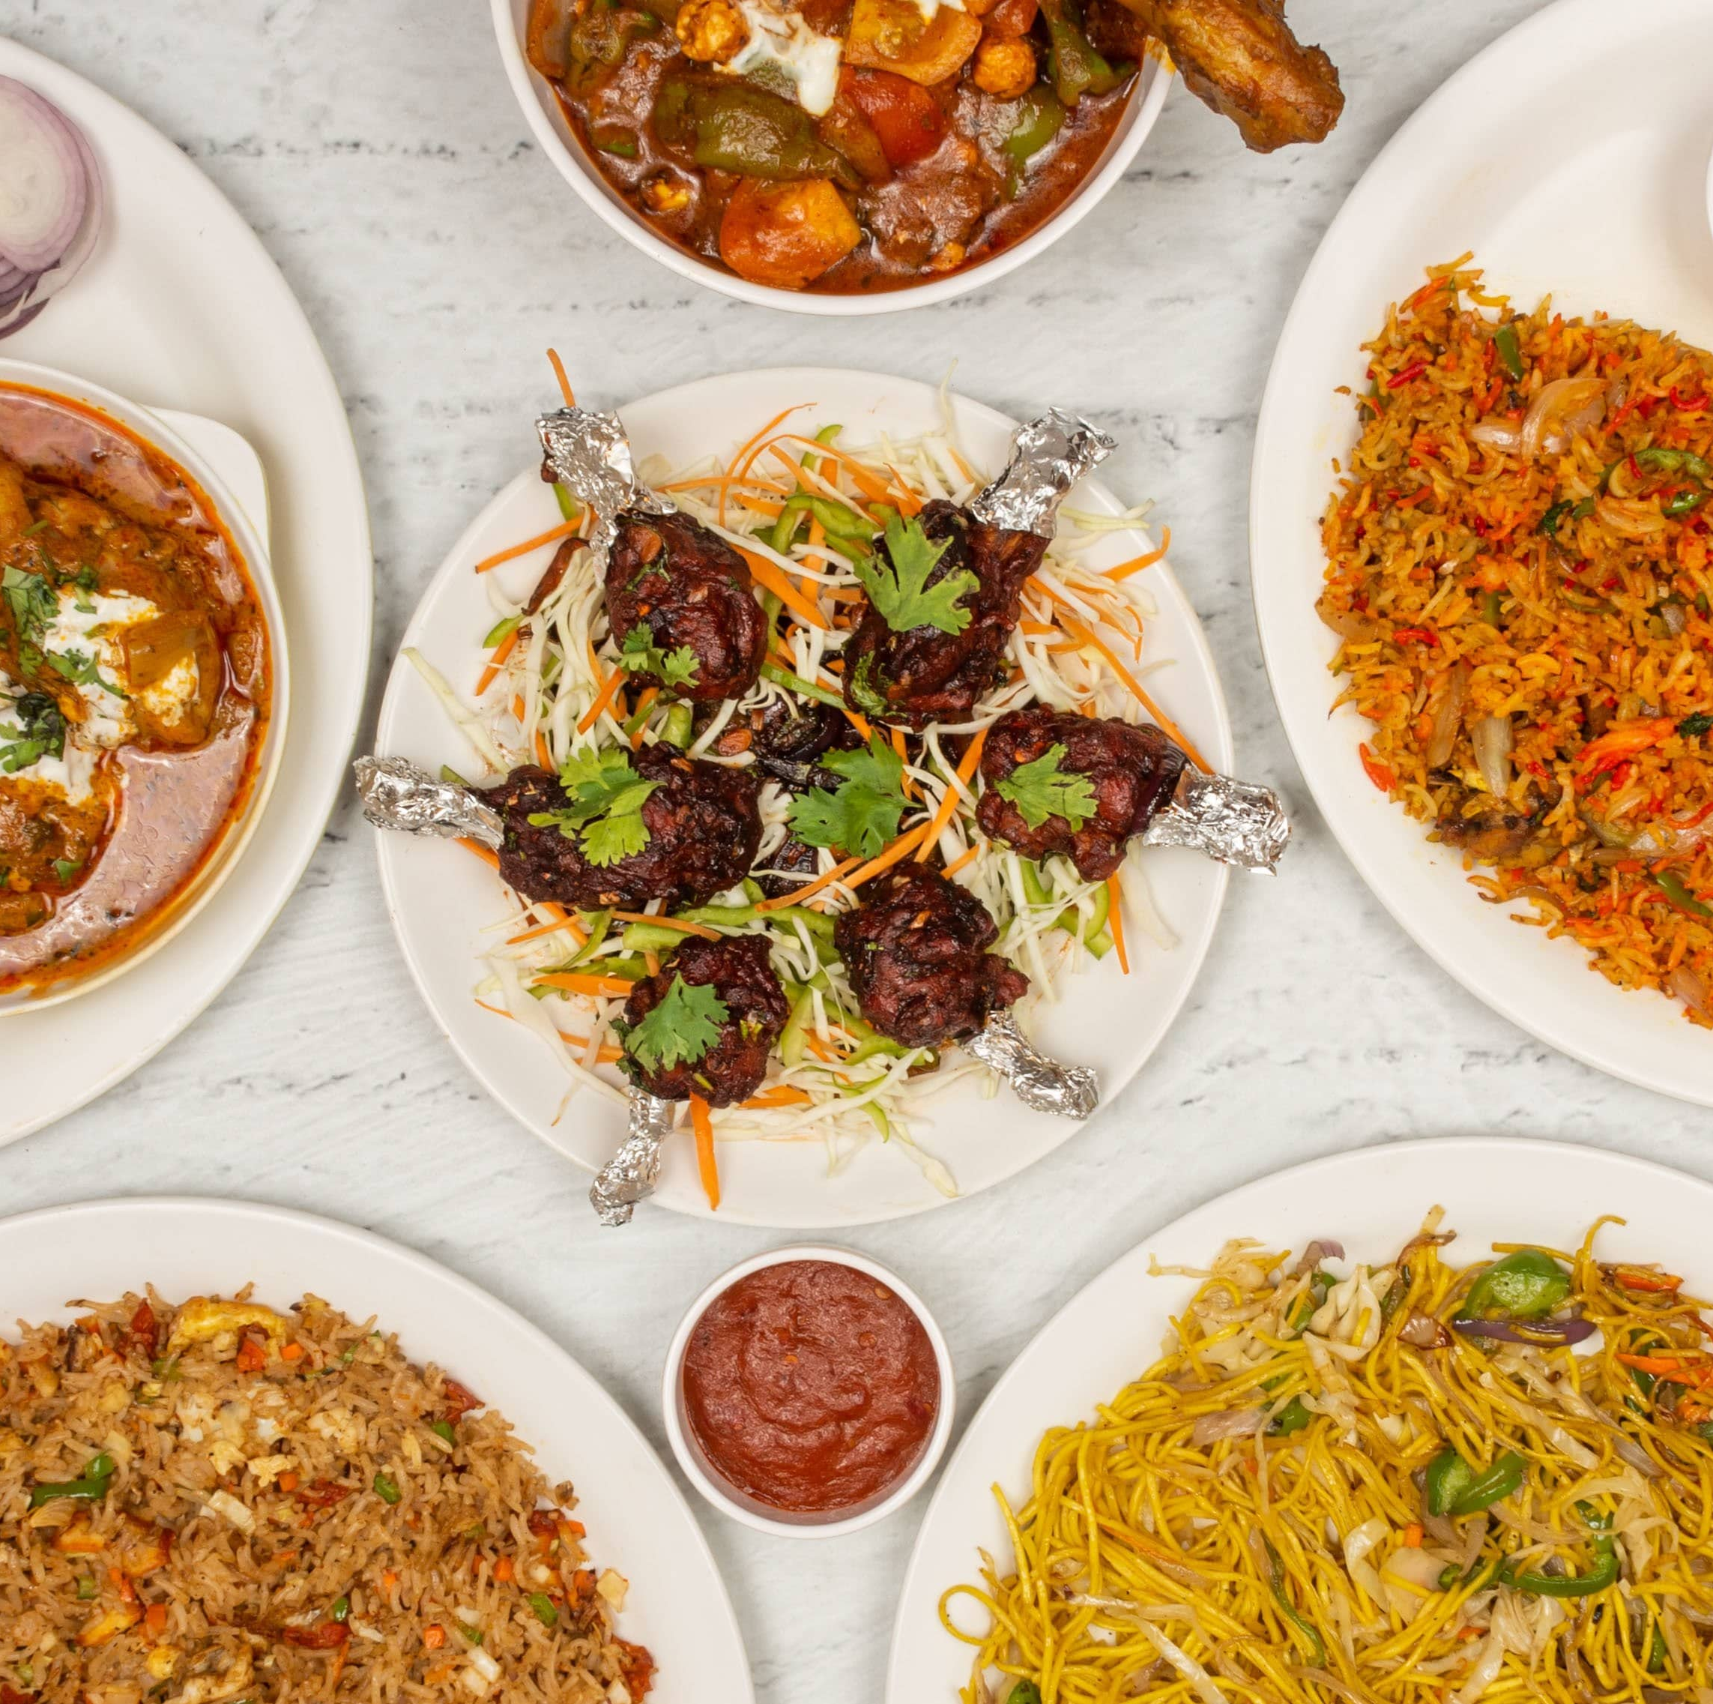

4P FOOD
Member of group:
CE130353 - Nguyễn Minh Thảo
CE130377 - Nguyễn Thành Nhân
CE130252 - Nguyễn Chí Linh
CE130364 - Cao Văn Kha
CE130213 - Dương Trọng Nhân
Mentor: Lương Hoàng Hướng

Slide 2
Table of Content
1
Problem Definition
2
Database Diagram
3
Class Diagram
4
The Overall Architecture Of The System
5
Usercase Diagram
6
Activity Diagram

Slide 3
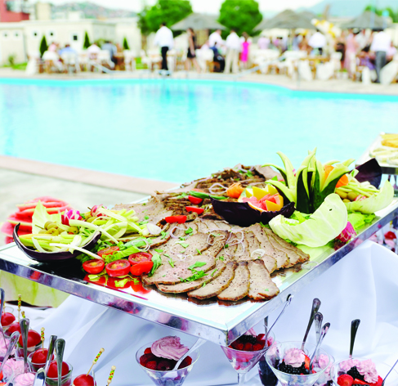
Problem definition
Building integrated restaurant and restaurant management applications for wrong purposes to help customers find places and place orders. 4PFood is a service that connects local culinary restaurants with the people. 4P has always brought people to the things that matter to them and now we are committed to bringing what matters closer to everyone. When you book a table with 4PFood, we will hold a seat for you at the restaurant and prepare the food you ordered on the app.

Slide 4
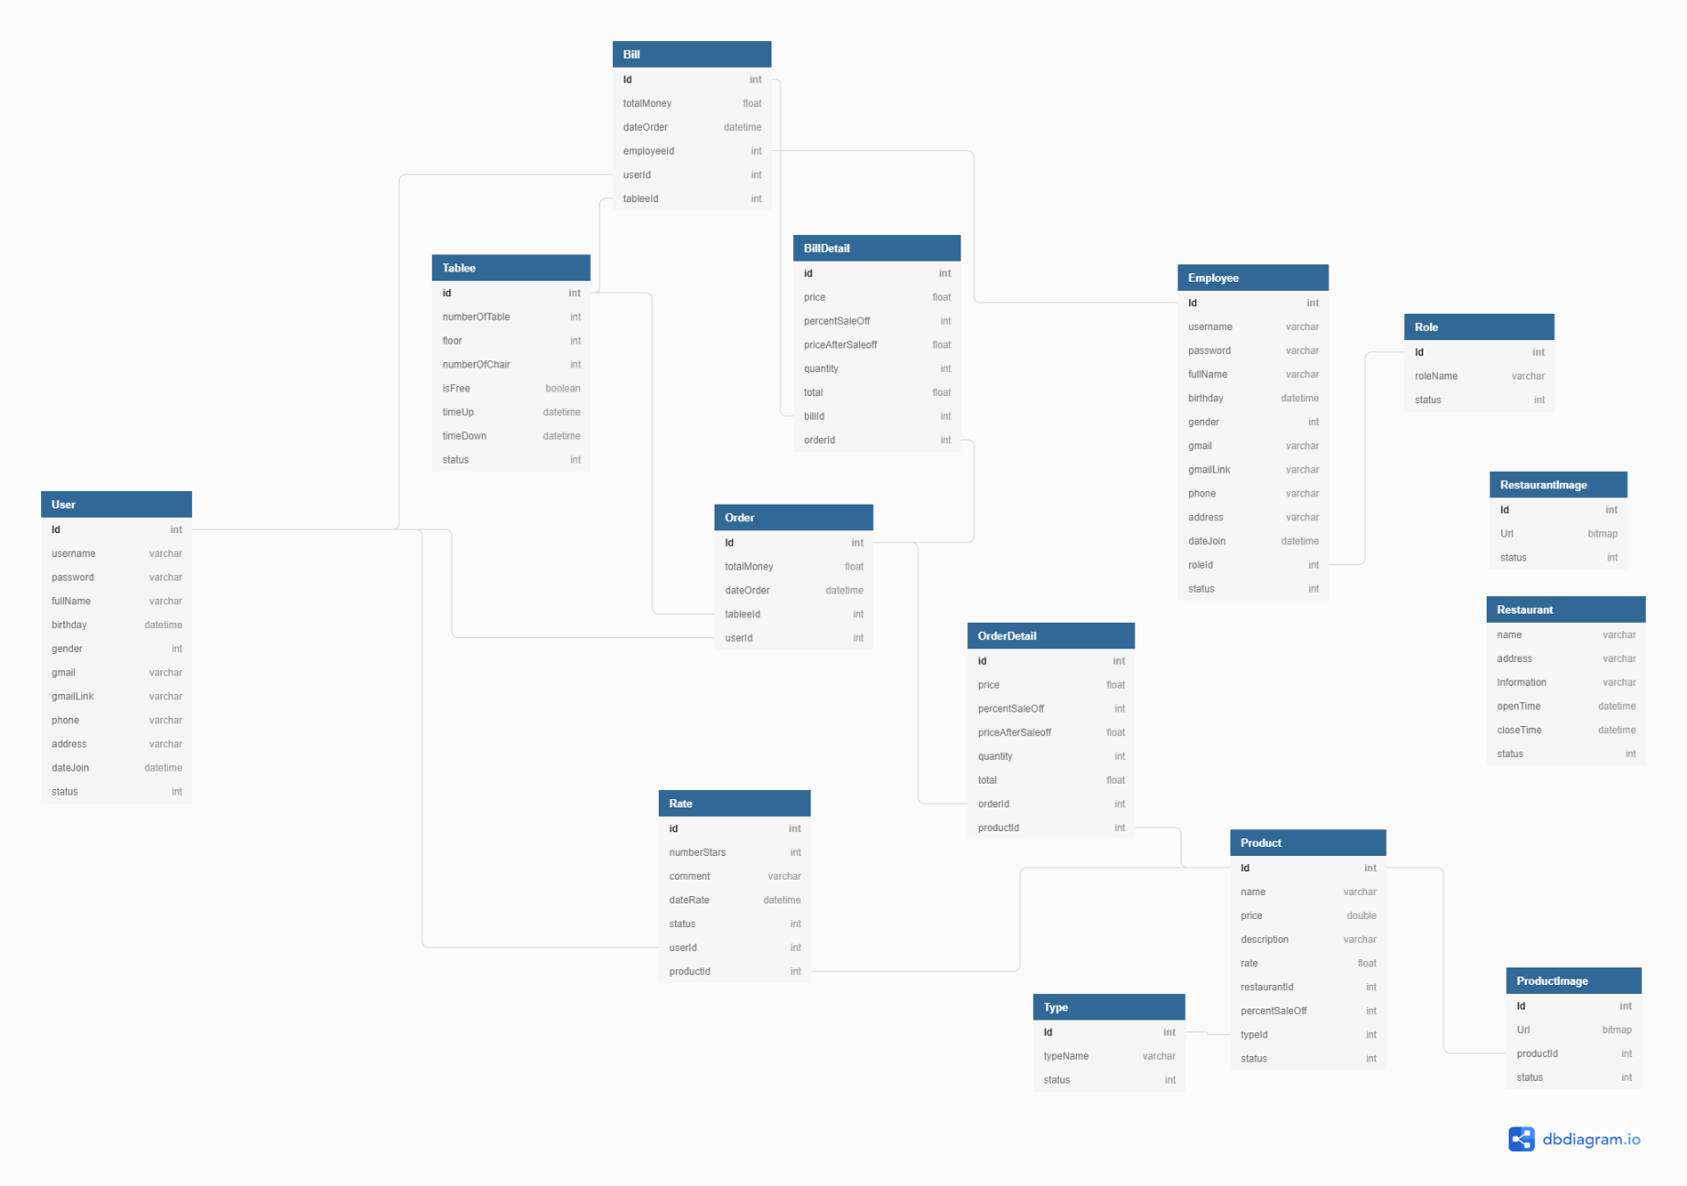
Database Diagram

Slide 5
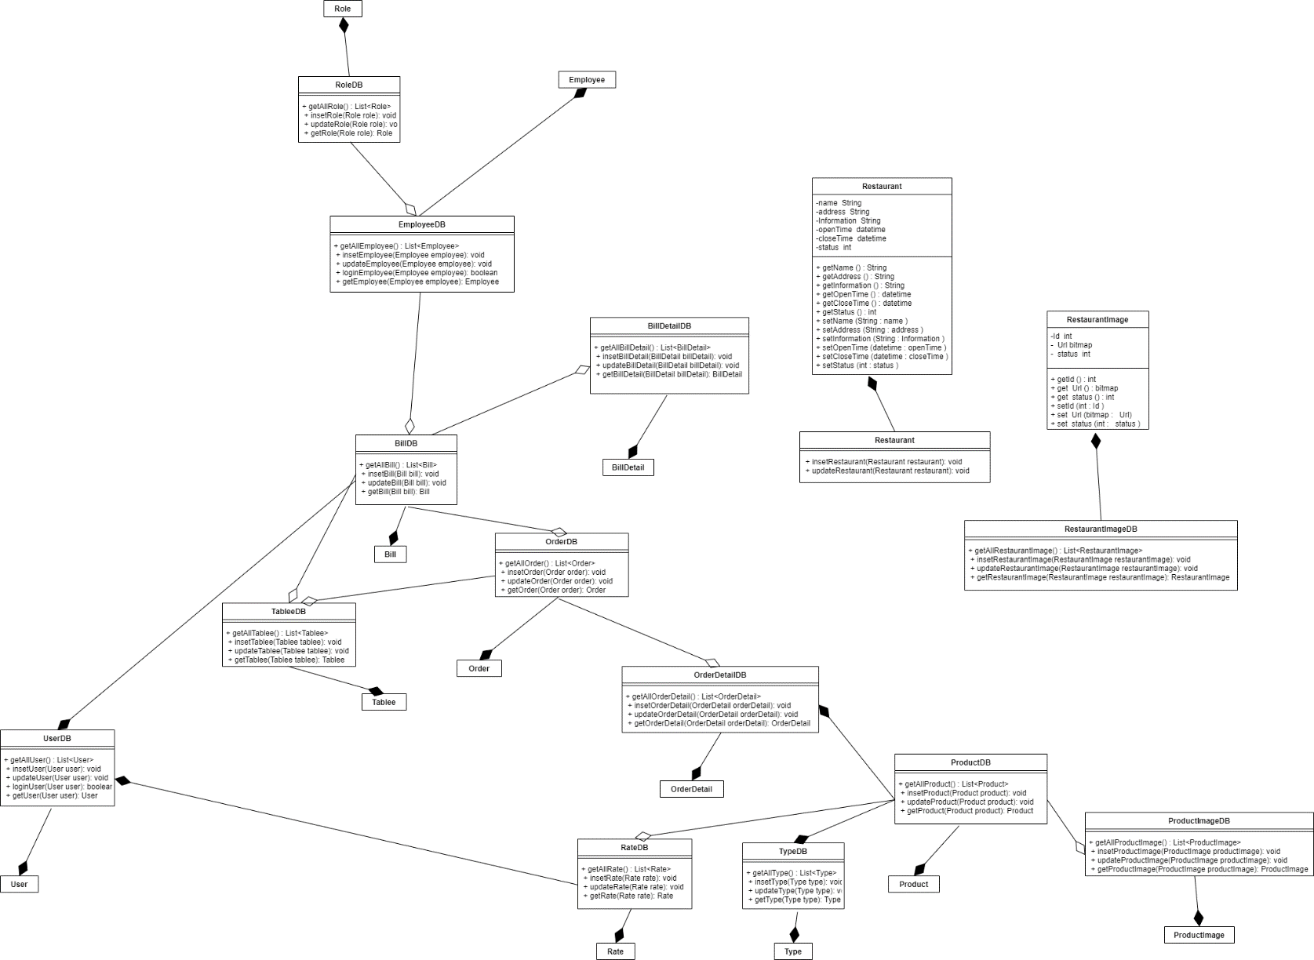
Class Diagram

Slide 6
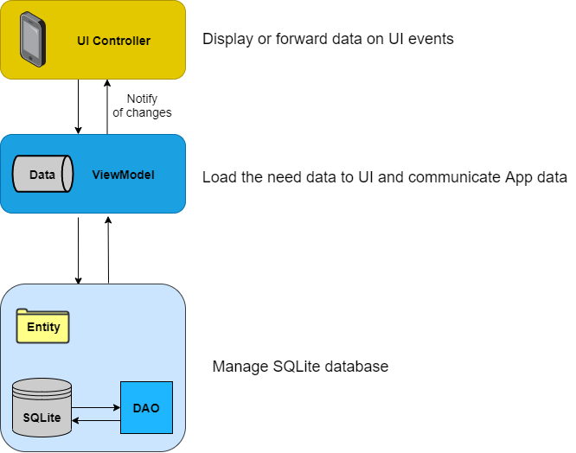
The Overall Architecture Of The System

Slide 7
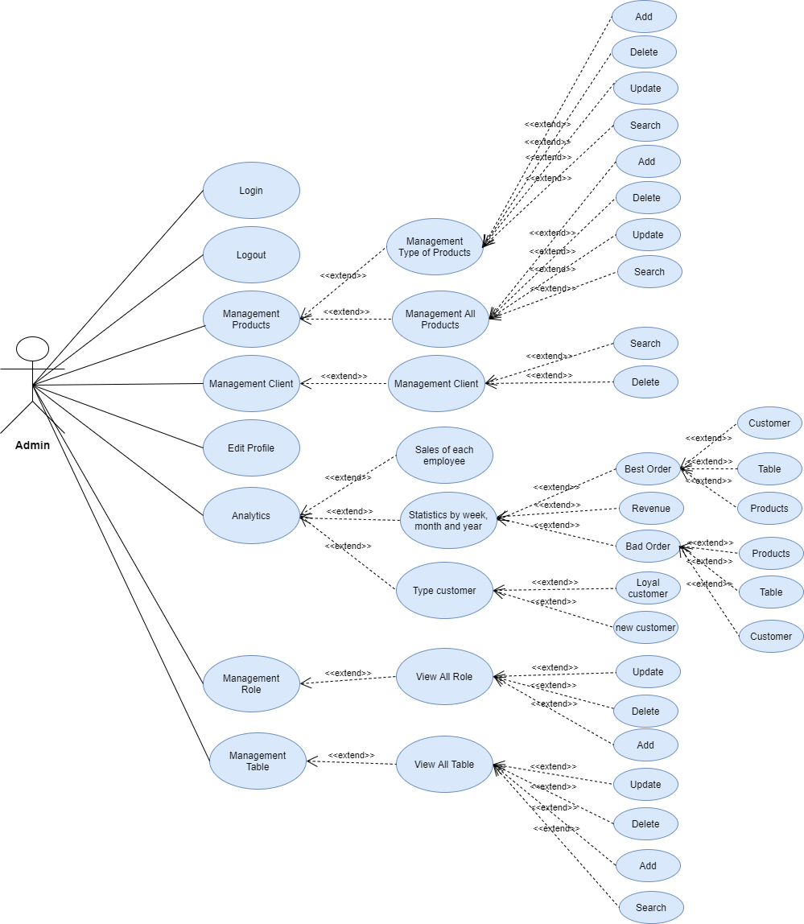
Usercase Diagram
Admin

Slide 8
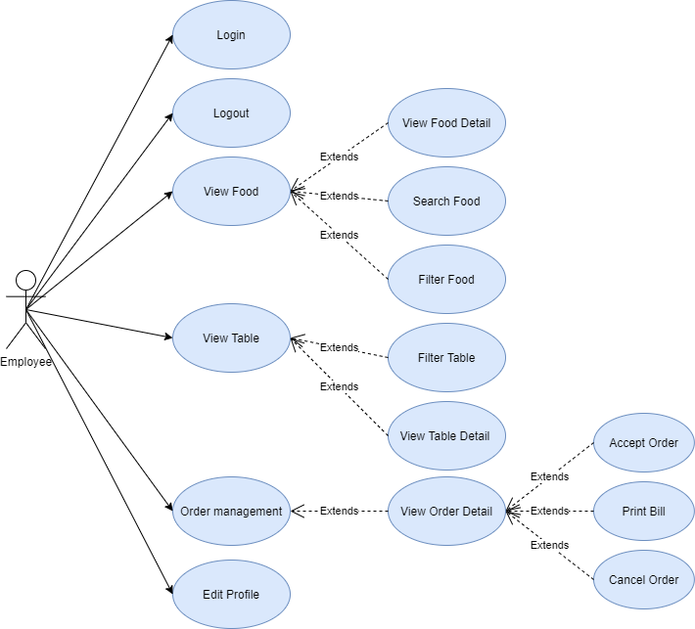
Usercase Diagram
Employee

Slide 9
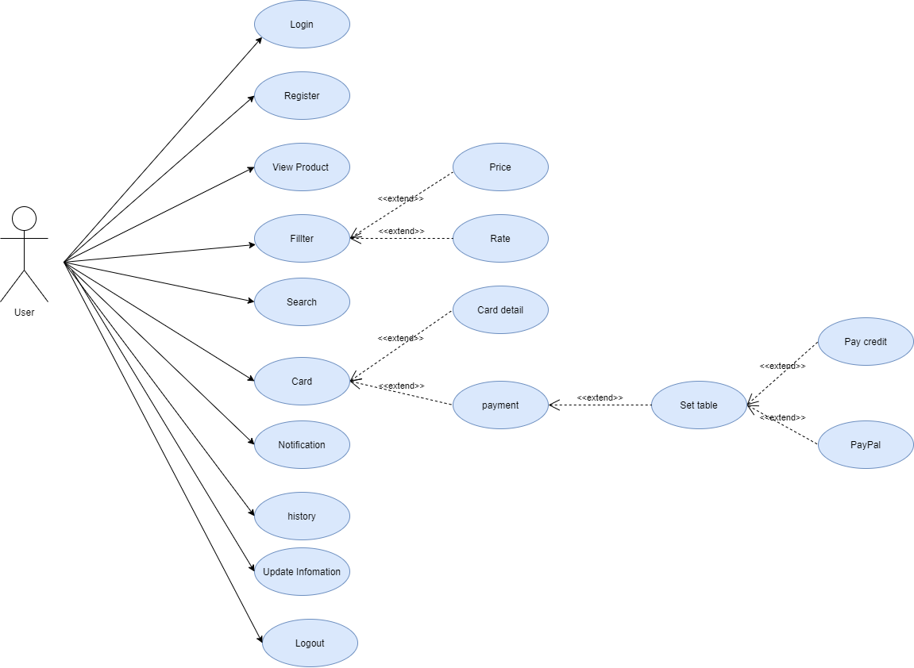
Usercase Diagram
User

Slide 10
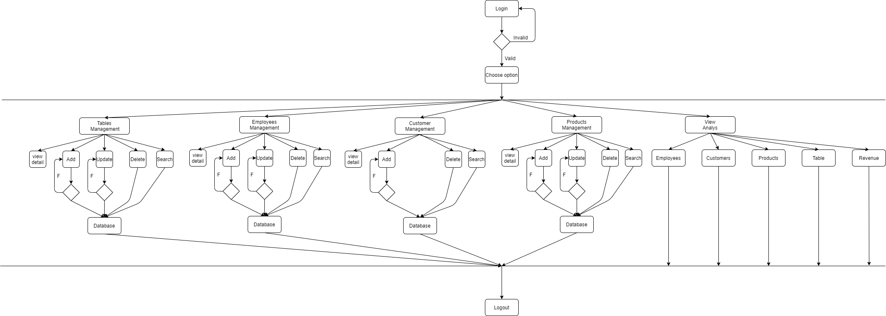
Activity Diagram
Admin

Slide 11
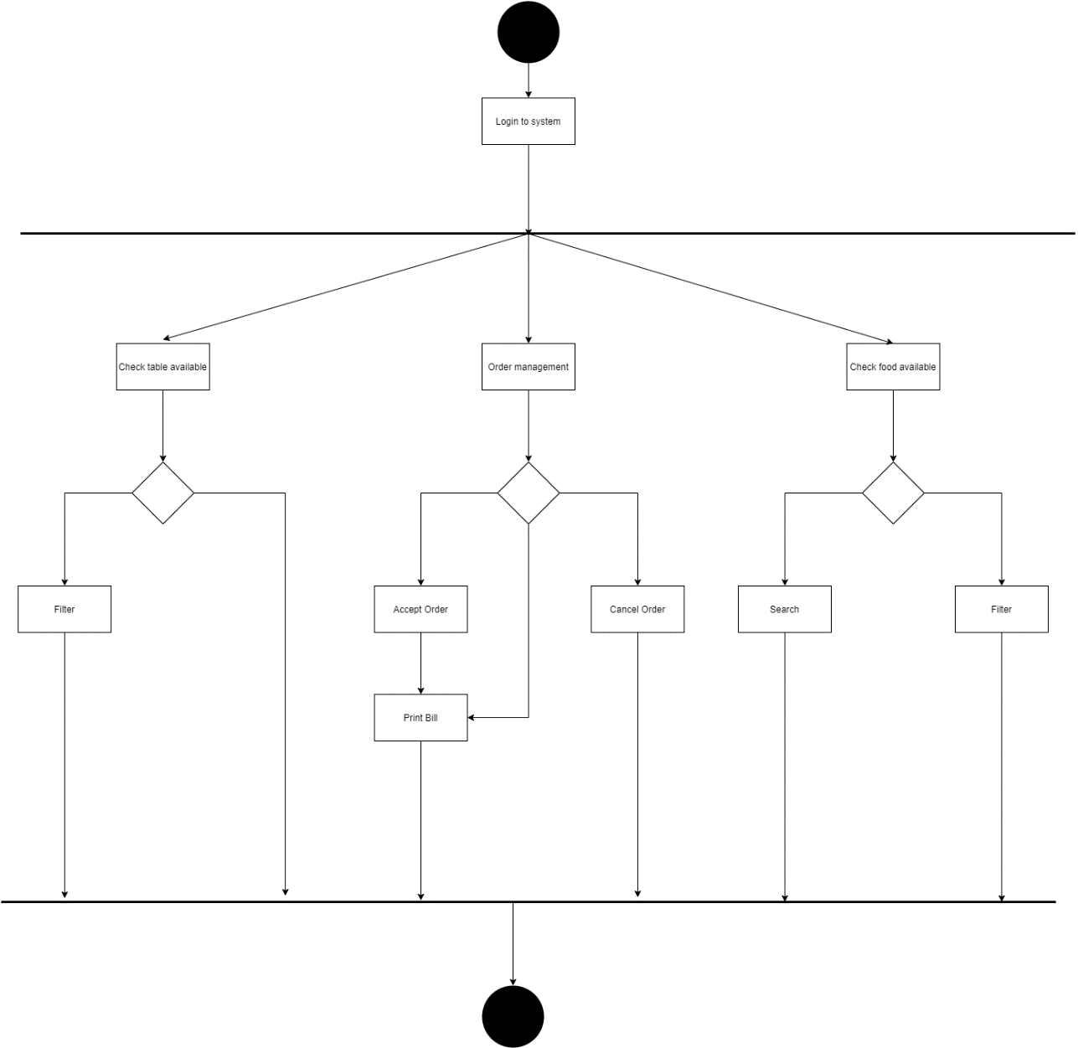
Activity Diagram
Employee

Slide 12
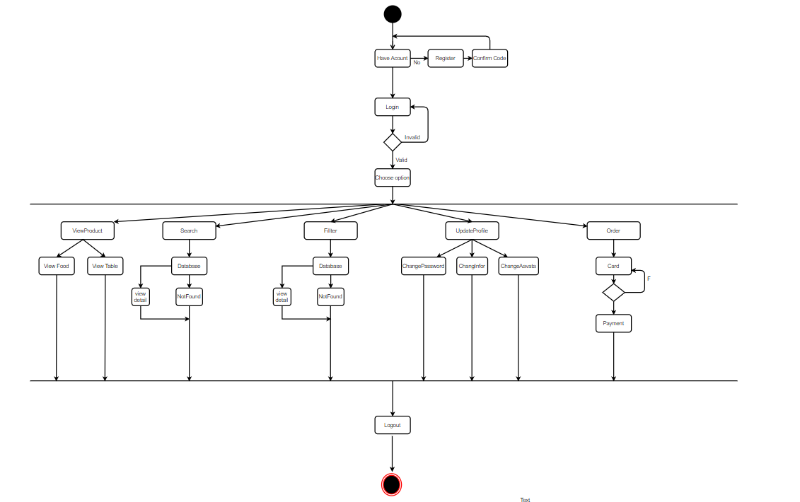
Activity Diagram
User

Slide 13
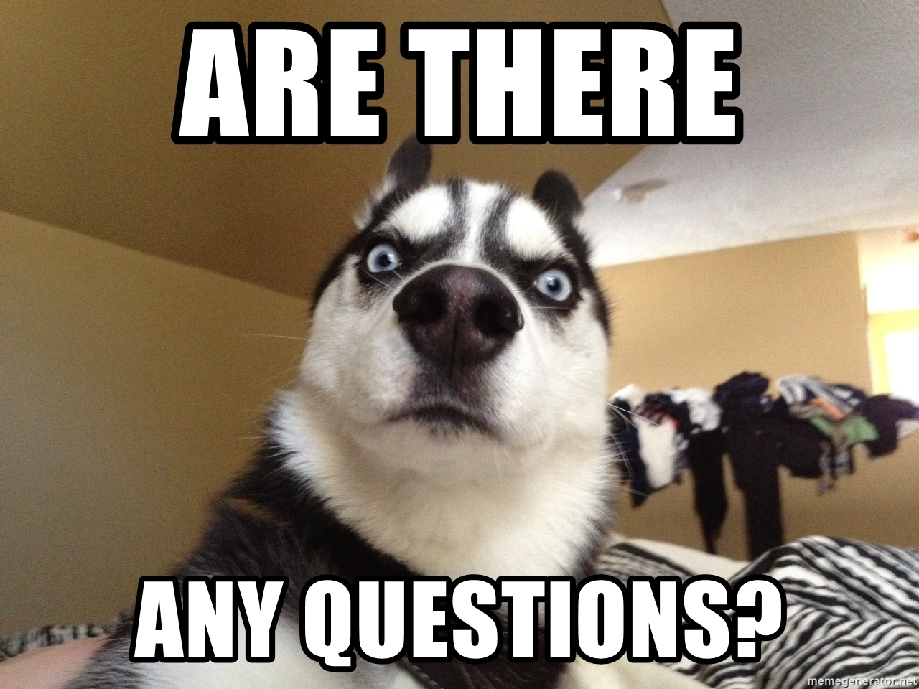
Questions and Answers

